Slide 1

Shortly about myself
An open person with a desire for self-development and learning, I have over 10 years of experience in networking and information technology.
I think, that the key to success in any business is hard work, a good sense of humor and striving for the best.

Slide 2
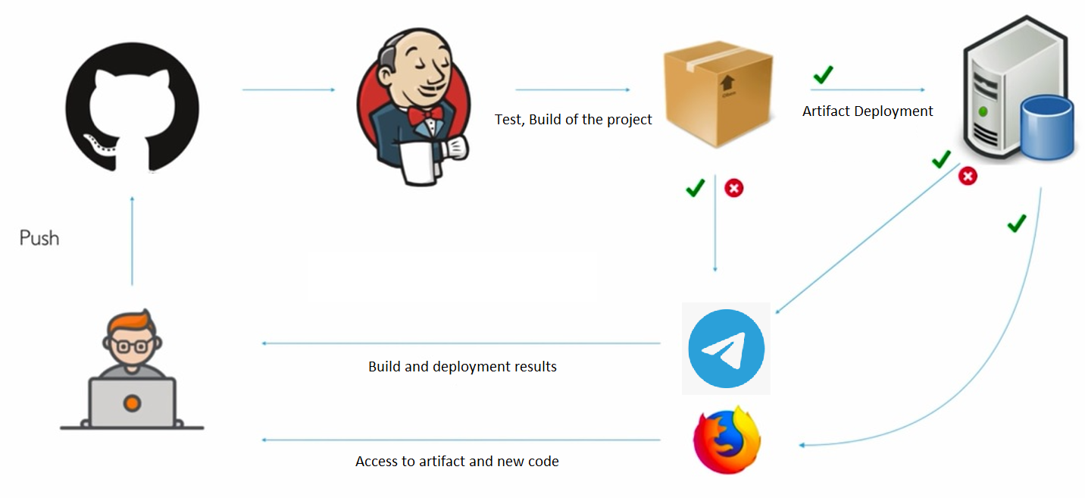
My goal

Slide 3

Main questions :
I have a resource limit (time, money, equipment, experience…), for this reson what tools can I use?
What location of the servers, services, network type should I choose? (Cloud solutions, VirtualBox, Linux OS or Microsoft Windows OS, MacOS).
How can Jenkins know about a new commit in the repository (webhook or pull paths)?
I need a reproducible and fast creation of infrastructure with backup.
I need to be notified about the state of the pipeline.
I need the secure process.

Slide 4
Tools used:
OC Microsoft Windows 10 (host computer).
Vagrant by HashiCorp.
Virtual Box Oracle VM:
- Ubuntu 20.04 LTS (bridged):
- Jenkins.
- Docker:
- Apache Maven.
- Telegram Bot.
Git hub
Docker Hub

Slide 5
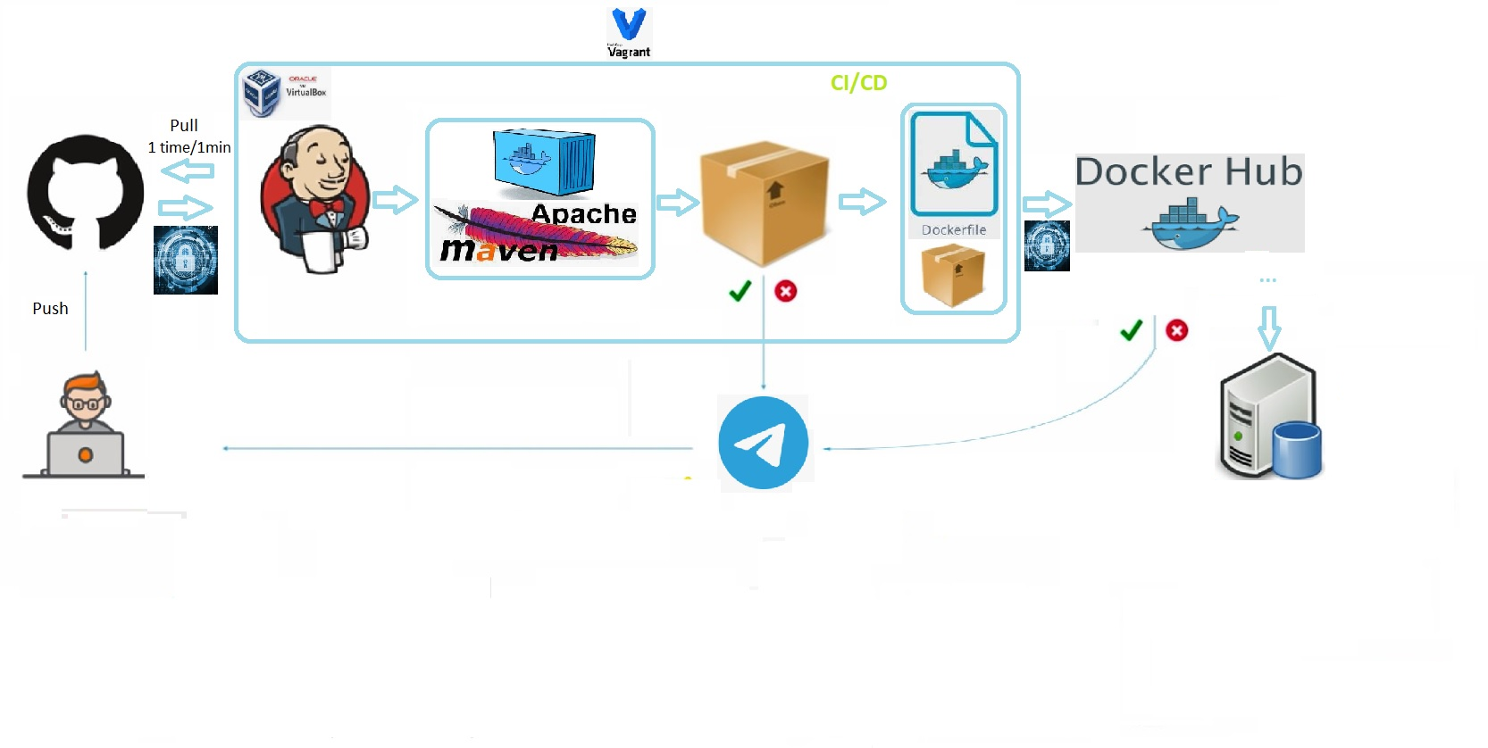
My pipeline

Slide 6
CI (continuous integration) process
The developer pushes the code to Git HUB.
Jenkins job sends a request to GIT HUB 1 time per minute. When he sees the changes in the repository, the pipeline starts.
The job starts a Docker container with Maven that builds and tests the project.
The result of the CI process is ARTIFACT (in current case this is jar file).

Slide 7
CD (continuous delivery) process
In the current pipeline, delivery starts with building a docker image which has artifact inside.
When the image is done, it is sent to the Docker Hub rep.
From Docker Hub, the image can be pushed to the Test environment, QA environment, to the stage/production server.

Slide 8
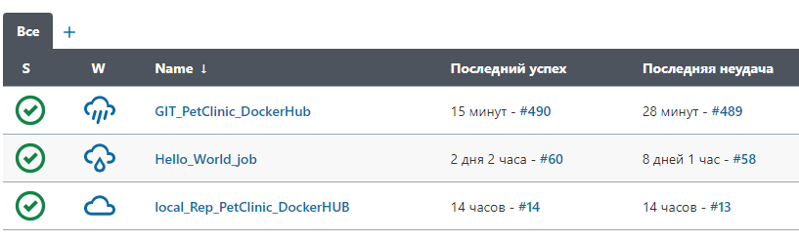
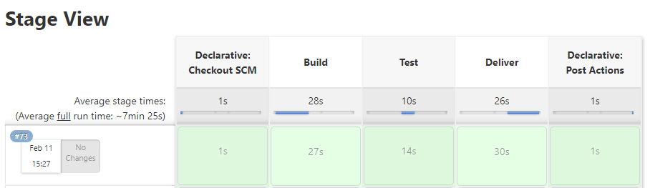
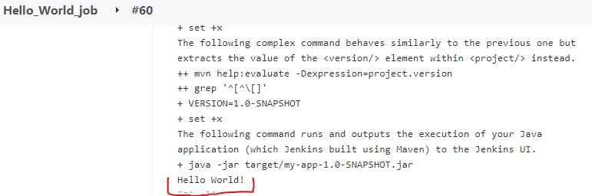

Slide 9
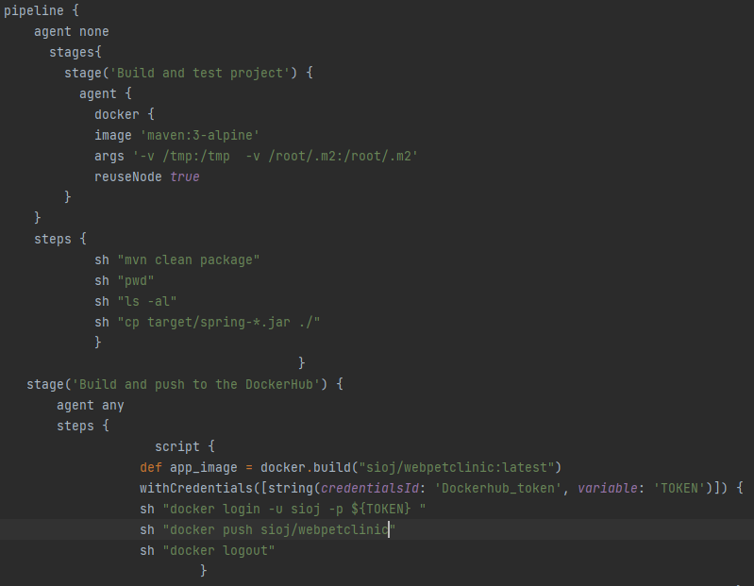

Slide 10
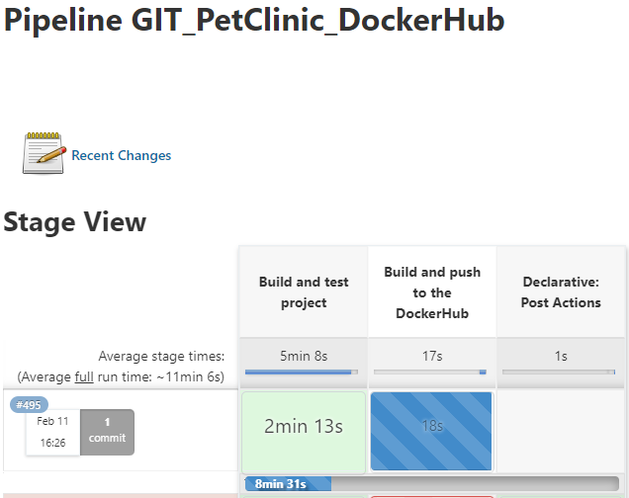
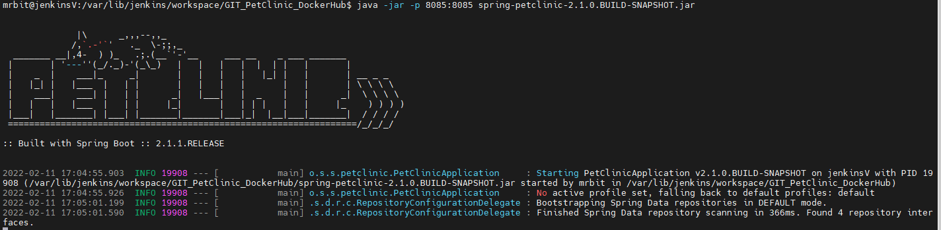
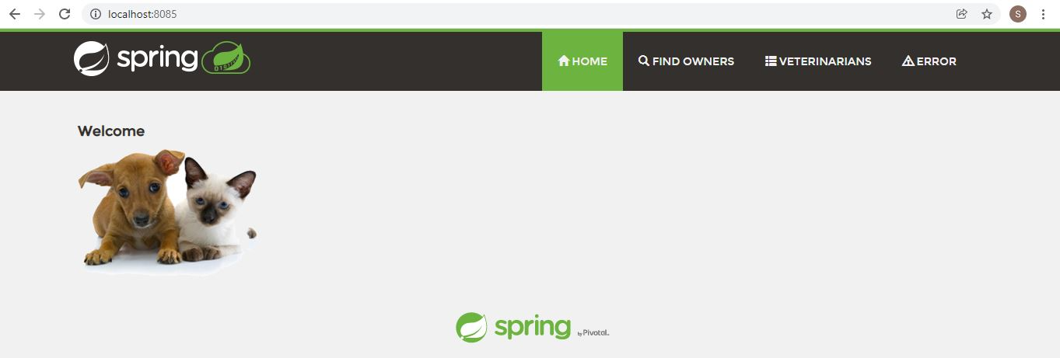
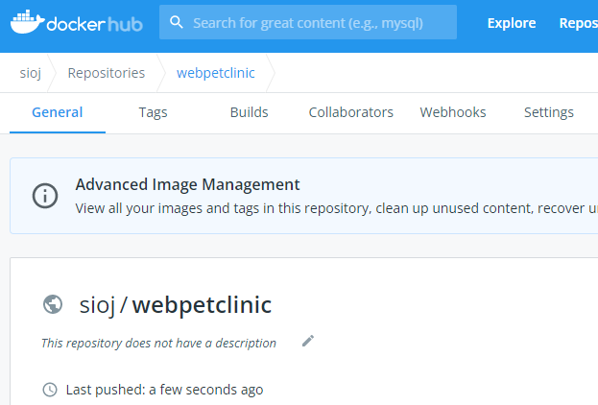

Slide 11
Q & A

